Slide 1
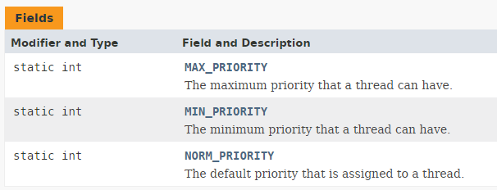
Priority of a Thread (Thread Priority)
Each thread have a priority. Priorities are represented by a number between 1 and 10. In most cases, thread scheduler schedules the threads according to their priority (known as preemptive scheduling). But it is not guaranteed because it depends on JVM specification that which scheduling it chooses.
Default priority of a thread is 5 (NORM_PRIORITY). The value of MIN_PRIORITY is 1 and the value of MAX_PRIORITY is 10.
Three constants fields are defined in Thread class

